Slide 1



Vehicle Emission Monitor
Real-Time Pollution Detection
VATSAL MAKWANA 25DCE050
ARCHI BHATT 25DCE009
KRISHNA GAJARA 25DCE026

Slide 2


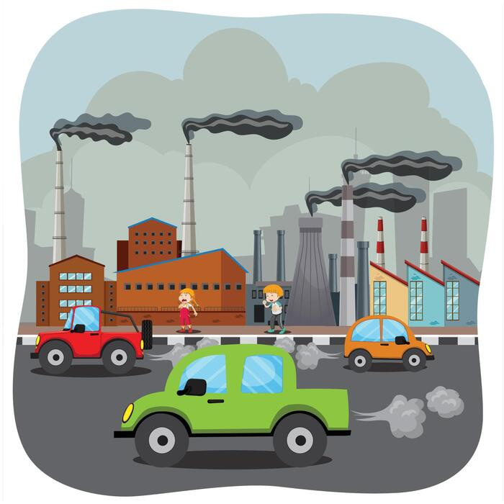


Introduction
The main idea behind this project is simple — Measure. Monitor. Protect.
This project focuses on detecting vehicle pollution in real time using an ESP32 microcontroller and an MQ-2 gas sensor.
Instead of checking pollution occasionally, we continuously monitor emissions and detect harmful spikes instantly

Slide 3
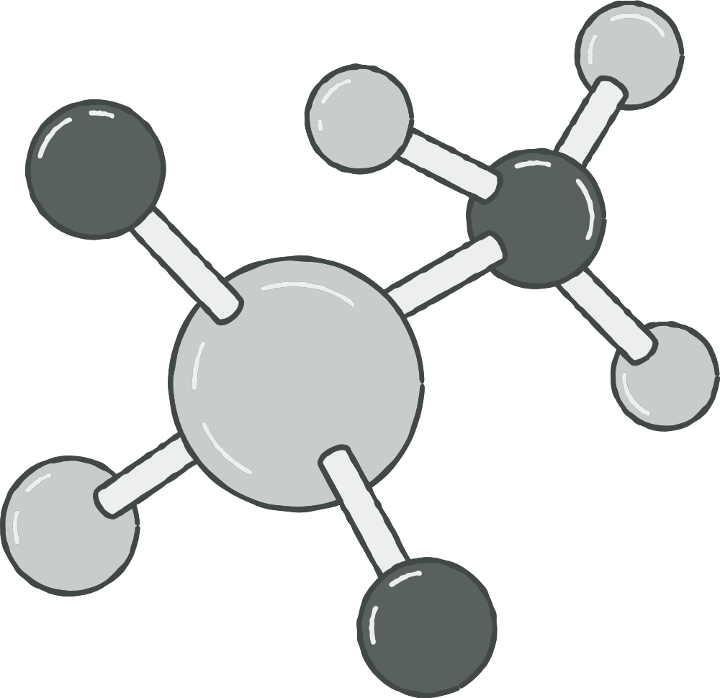
Why Do We Need This?
“Air pollution is a major problem in India, especially in urban areas.
Vehicles are the number one source of pollution, releasing harmful gases like carbon monoxide and particulate matter.
These pollutants cause serious health issues such as asthma, lung infections, and even long-term diseases.
Currently, we rely on PUC (Pollution Under Control) checks, but they are done only once every 6 months.
This means a vehicle can pollute heavily in between without any detection.
Also, there is no real-time system at traffic signals to identify highly polluting vehicles.
So, there is a clear need for a low-cost, real-time monitoring solution.”

Slide 4

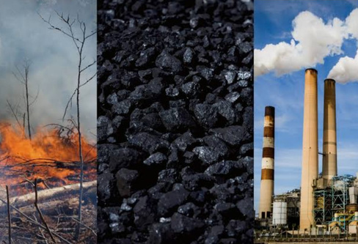
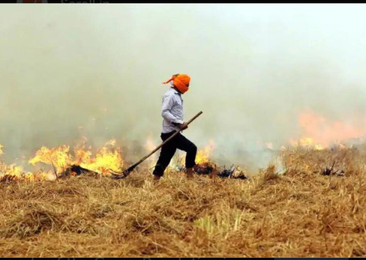
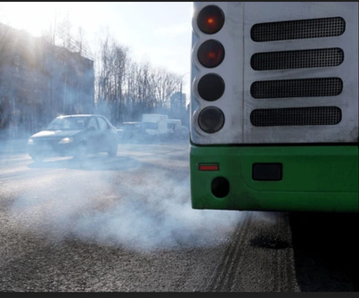
Sources of Air Pollution
Vehicle emissions
Industrial activities
Burning fossil fuels
Agricultural processes

Slide 5

VAHANSETU
To demonstrate the project, we have created a live website.
It shows simulated real-time PPM values along with a waveform graph.
SCAN THIS
One of the key features of the website is the live waveform graph, which visually represents pollution trends over time. This helps users observe patterns, spikes, and peak emission values clearly.

Slide 6
VAHANSETU
It firsts asks new user to create their account. Existing user have to login
In which user should add email and password.
Then it opens a page where user has to enter their name,mobile number,vehicle number,aadhar number.
t shows simulated real-time PPM values along with a waveform graph.
One of the key features of the website is the live waveform graph, which visually represents pollution trends over time. This helps users observe patterns, spikes, and peak emission values clearly.
It also shows the user their paid fines and pending fines which they have to pay.
It creates a receipt for fine that has been paid.
Payement can be done through card,netbanking,etc.

Slide 7
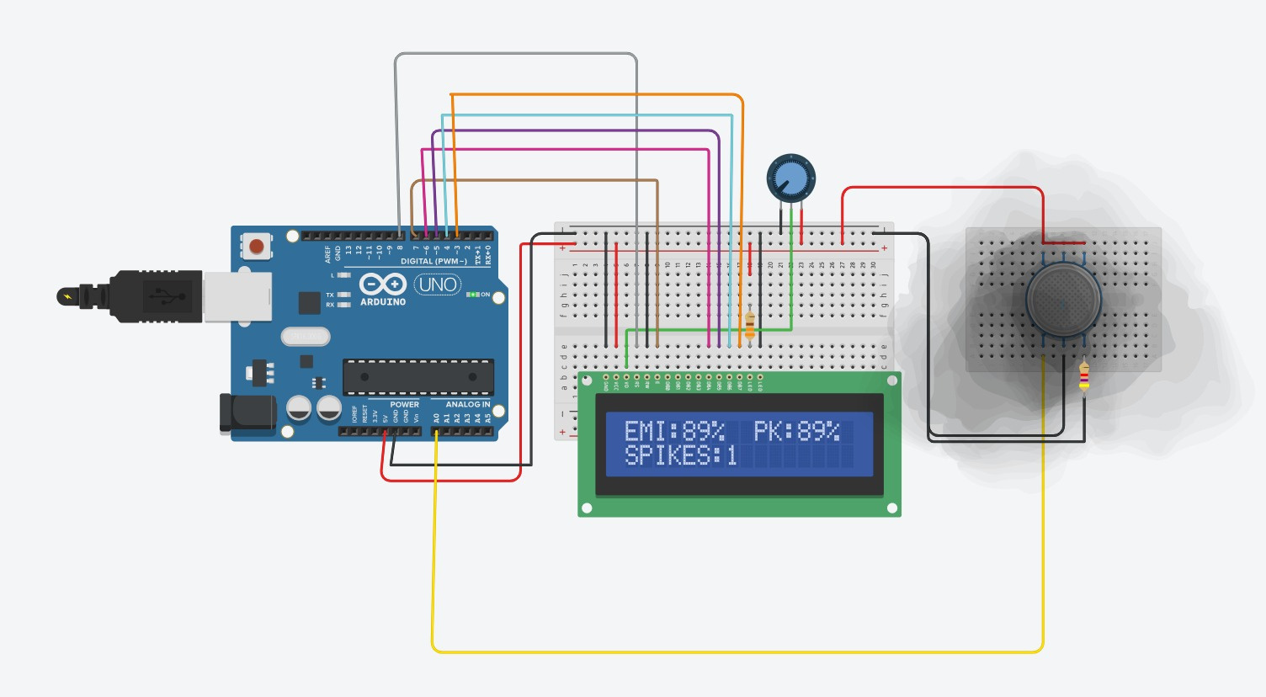
Hardware Stack

Slide 8
Components Used
This project uses simple and affordable components.
  The ESP32-S acts as the brain of the system. It processes sensor data.
  The MQ-2 gas sensor detects smoke and harmful gases like CO and LPG.
  A 16×2 LCD display shows real-time readings.
  A potentiometer is used to adjust the display contrast.
  Breadboard and jumper wires are used for easy connections without soldering.
All components are easily available and beginner-friendly.”

Slide 9
How It Works
“Let’s understand how the system works step by step.
First, the MQ-2 sensor needs about 60 seconds to heat up and calibrate itself in clean air. This helps it set a baseline value called Ro.
After that, the ESP32 reads analog signals from the sensor every 50 milliseconds.
These signals are converted into PPM values using a mathematical formula.
To make readings stable, we use a smoothing technique called Exponential Moving Average.
The system also detects spikes — if the pollution suddenly becomes twice the normal value, it flags it as a spike.
This helps identify sudden emission bursts from vehicles.”
  The LCD screen shows all important information in real time.
  It shows EMI,PEAK AND SPIKES
  PEAK means highest amount of emission in the testing time
  SPIKE means how many peaks have been reached.

Slide 10



CONCEPT
  Rs​ = Sensor resistance in polluted air
  Ro​ = Sensor resistance in clean air (calibrated value)
  A, B = Constants (from MQ-2 datasheet graph)
  Vc​ = Supply voltage (usually 5V or 3.3V)
  Vout​ = Analog output from sensor
  RL​ = Load resistance (e.g., 10kΩ)

Slide 11
Where to Attach the Device on Vehicle
“The device should be placed close to the vehicle’s exhaust outlet, because this is where polluted gases are directly released.
The MQ-2 gas sensor must be exposed to the exhaust smoke to accurately detect harmful gases like carbon monoxide and smoke particles.
However, it should not be placed directly inside the exhaust pipe, because:
  The temperature is very high
  Direct heat can damage the sensor
  Continuous strong airflow may give unstable readings
So, the best position is slightly away from the exhaust outlet.”

Slide 12
Where to Attach the Device on Vehicle
  Near Exhaust Tip
  Fix the sensor 2–5 cm away from the exhaust pipe
  Use a small bracket or clamp
  Ensures accurate and fast readings
  Rear Bumper Area
  Mount under or near the rear bumper
  Protects sensor from direct heat
  Still captures exhaust gases effectively
  Inside Protective Case
  Place ESP32 and LCD inside a small box
  Only expose the MQ-2 sensor outside
  Protects electronics from dust, water, and vibration

Slide 13
Advantages
Why This Project Stands Out
“This project has several strong advantages.
First, it is extremely low-cost — only ₹700.
Second, it provides continuous real-time monitoring, unlike traditional PUC checks.
It automatically calibrates itself, so no manual setup is required.
It can detect sudden spikes, which many systems ignore.
Also, it works completely offline, making it portable and easy to use anywhere.”

Slide 14
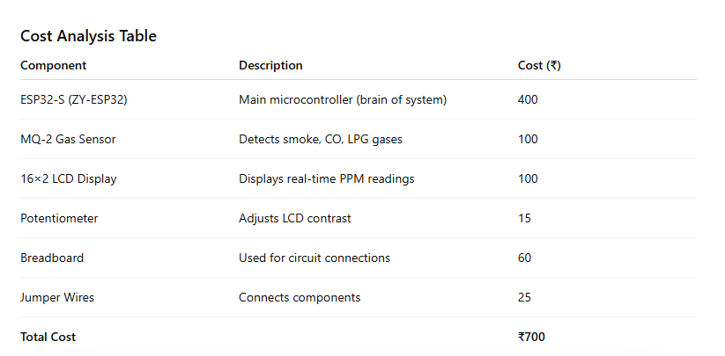
Cost Analysis

Slide 15

Future Scope
What Can Be Added Next
“This project can be improved further with additional features.
We can add Wi-Fi to send data to a cloud dashboard.
A camera with OCR can capture vehicle number plates automatically.
A GPS module can help map pollution hotspots in cities.
We can add buzzers and LEDs for better alerts.
A mobile app can also be developed using Bluetooth connectivity.
These improvements can make the system smarter and more useful.”

Slide 16
Conclusion
“To conclude, this project successfully demonstrates a real-time vehicle emission monitoring system.
It detects pollution levels, peak values, and sudden spikes efficiently.
It is low-cost, portable, and easy to use.
With further development, it can be scaled for smart city applications and environmental monitoring systems.

